Slide 1
Engineering Dashboard
Robert Ryan

Slide 2
The Executive View
Engineering development plans
Roadmap of committed projects
Detailed plans can be found on the Project Servers
Key Code
10
11
12
1
2
3
4
5
6
7
8
9
Detailed Engineering Plan
Black – Full Plan
No line – Plan in development
Committed Date
Project Name
Project Status
Green – On Schedule
Yellow – At Risk
Red – Missing Schedule

Slide 3
Table of Contents
M-Series
F-Series
Circuit Breakers and SFRA
ARMS
Innovation Center for On Line Systems
DGA Projects
IT Tools /ERP
IT Infrastructure

Slide 4
M-Series
Engineering Development Plan
Return to Table of Contents

Slide 5
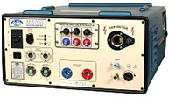
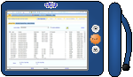
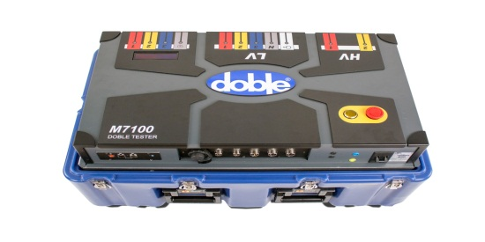

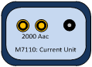
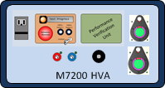
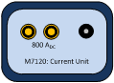
M-Series Engineering Development Plans
Hardware
Software
M4100
DUC
DTAFv5.7
M4Kv4.2
M7100
M7-Truck
DTA6
M7110
DTA7
M7200
M7120
DTA Web
DUC Launcher

Slide 6
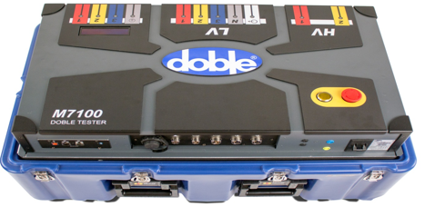
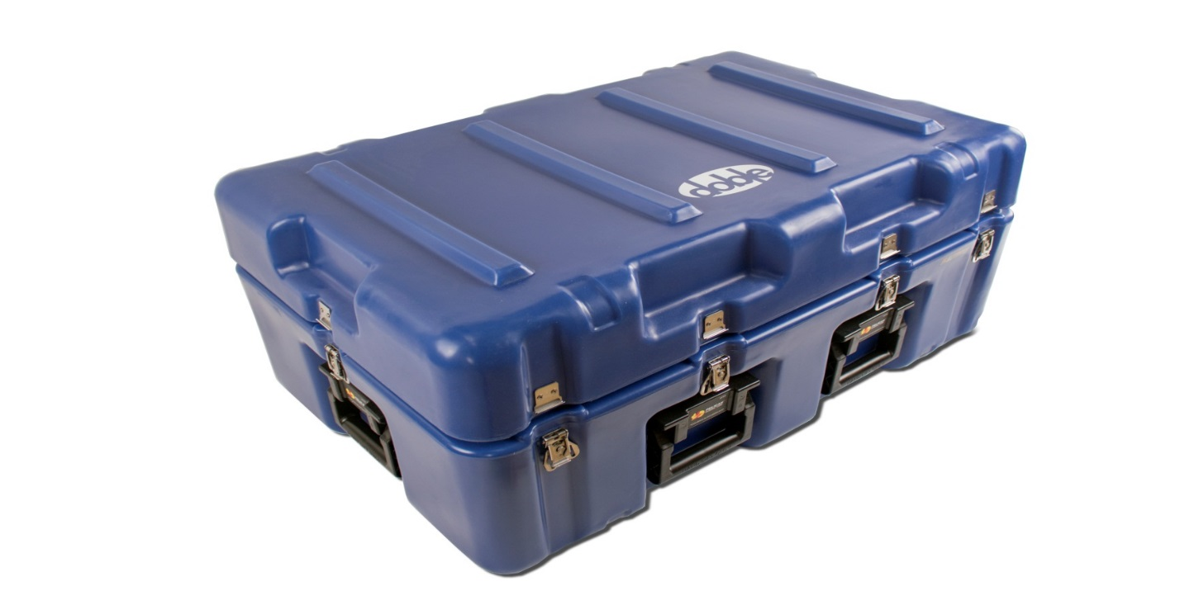
M7100 Industrial Design

Slide 7
M7 Initial Release Summary
Wiki
M7 Wiki page: https://doblewiki.doble.com:8443/display/MSS/M7100
Manuals: https://doblewiki.doble.com:8443/display/MM/M7100+User+Documentation
Field Test: https://doblewiki.doble.com:8443/display/MSS/M7+Field+Test+Issues+Review
Initial Product Release
Features
M4100 + M4110 + TTR Cap
HV Power factor – 2 leads
Exciting Current
Leakage Reactance
HV TTR
New Capabilities
Load Tap Changer Control
LV TTR
DC Winding Resistance
HV Variable Frequency Power Factor
CE / Safety Compliance

Slide 8
M7 Engineering Status – May 2016
M7100 shipments in May
1 Sale system: Australia (AusiTech)
Other shipments
Repaired and returned Xcel and Bonneville Power instruments
M7100 Systems
Fielded Units
12 Sold
1 Lease Customer
1 Beta Customer
7 Demo Pool
Additional 10 systems ship ready

Slide 9
M7 Engineering Status – May 2016
Development and SQA in progress for next hotfix release
FW 1.2.7 & DTA 7.4.3 Fixes and enhancements – highlights:
Resolved field issue - Overall Test “C2” measurement (MSOHFD-953)
Increase DC Winding Resistance maximum current to 35A
Support Demag on high winding resistance apparatus and address other field issues
Improved error messages and operator guidance in DTA
Add Customer Support requested feature in DTA to automate logfile retrieval and upload to Doble (replaces manual script-based process)
Expanded diagnostics to include Source & Measurement Validation to verify calibration state of instrument
Target release for end of June
Supporting system test and calibration
Var Feq Power Factor calibration extended

Slide 10
M7 Engineering Status – May 2016
Supporting the next manufacturing build (Rev5 HW)
Next 5 systems nearing assembly completion
Brings Rev5 system completion to 16
Rev5 system build plan increased from 25 to 30 systems
Based on available material, with only very small additional material buy
Allows for 5 spares of each module
M7 build transition to MCA started
MCA staff on-site in Watertown for M7 training session
Training for 3 lower chassis modules: LVS, PFC, Main Reference
Assembly of LVS, PFC & Main Reference will start at MCA in July
BOM transfer to MCA and load of MCA systems will take place in June

Slide 11
M7 Engineering Status
DFR development and test continues along multiple fronts
Setup #1: M7 with an linear amplifier power supply
Used by the firmware (FW) team to develop and debug the FW
Development system for a stand along DFR system
Develop and debug the Measurement Module
Setup #2: M7 (including the LVPS)
Used by the hardware team debug and remove the noise
Hardware improvements underway
Signal quality at 1000Hz
Thermal issues at very low frequencies
1093 rev 1 measurement board integration and testing with 2.0 FW state machine and DC offset control

Slide 12
M7 Engineering Status
Key Development Tasks - June
DFR
continue Lab testing with 1093 rev 1 measurements
Submit 1093 rev2 board spin
Plan for FW and DTA
Release hot fix FW 1.2.7 and DTA 7.4.3
Start development of next major DTA hotfix release
Add support for transformer winding configuration support in nameplate
to provide full lead configuration for LVTTR test
will replace the current manual work-around
Plan for M7 Build at MCA
Release BOM to MCA of lower chassis modules
Allows MCA to load their systems to assemble at MCA Florida

Slide 13
Protection Systems
Engineering Development Plan
Return to Table of Contents

Slide 14
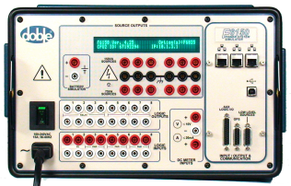
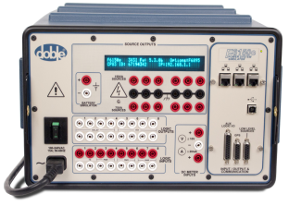
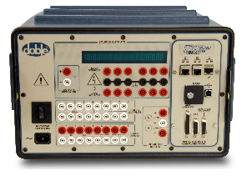
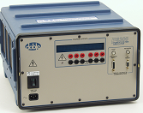
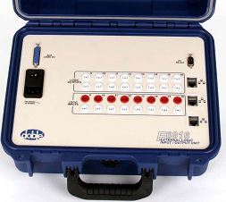
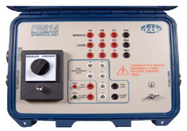
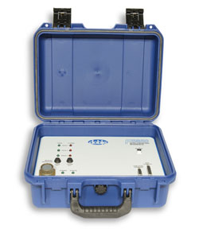
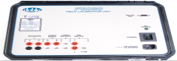
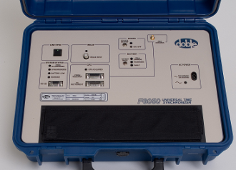
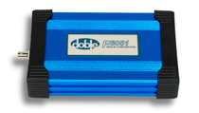
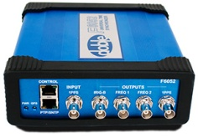
F-Series Engineering Development Plan
Hardware
Software
F6150
F6150e
F6150sv
F-Series FW
ProTesT
F6300e
F6816
F6350e
F6TesT
Protection
Suite
RTS
61850 Test
F5814
F5850
F6080
Mobile Control Panel
F6Multi-Amp
Controller
F6050
F6051
F6052
PowerBase
Protection
Web
F5851
F8000

Slide 15
June 8th Status F-Series
IEC 61850 Conformance Tests for F6150sv – completed in March 2016 for the following parts
IEC 61850 Edition 2 Parts 6, 7-1, 7-2, 7-3, 7-4, 8-1
IEC 61850 Edition 1 parts 6, 7-2 and 9-2
Official test reports and certificates received in April 2016.
F6 Power System Simulators: Release completed and below instruments are in production
F6150e and variants for conventional protection schemes:
F6150e
F6150e-D
F6150e-SP
F6150e-IRC
F6150e-3I
F6150sv and variants for conventional and IEC 61850 protection schemes.
F6150sv
F6150sv-SGD
F6150sv-IEC
F6350e:
Power system simulators compatible with RTDS.
F6300e:
Power system simulators for providing additional 12 current sources with F6150e/sv and compatible with RTDS.

Slide 16
June 8th Status F-Series
F6 PCB Updates to Replace Obsolete Xilinx Components: Release completed and below boards are in production
CPU Board
F6 Analog I/O Board
Enhanced I Amplifier Board
Convertible V/I Amplifier Board
Logic I/O 4 Board
AIM Board
Power Supply Board
F6150sv sampled value PCB updates:
SV FPGA cable released in April 2016. SV FPGA field update kit planned to be released by June 2016.
F6 FPGA’s
Sampled value v4.0 with enhancements for supporting IEC 61850 edition 2 changes completed in September 2015.
CPU v5 with ability to field program the SV FPGA & other enhancements is in SQA. Planned to be released by July 2016.
IntelliRupter / Recloser Cable Harness (F5851): Release completed for 14 & 32 pin configurations
14 & 32 pin cables are available for customer shipments. Issues reported by Florida Power & Light have been resolved.
Requirements for F5851 24, 26, 19 pin cables are presently being scoped by engineering & solutions.
24 pin prototype assembled and provided to TAE’s for demo to AvanGrid in March 2016. Feedback is pending.

Slide 17
June 8th Status F-Series
FW v4.31.3 – Release completed in December 2015
Version to fix Ethernet communication errors by changing data transfer speed
FW v5.6.0 – Release completed in December 2015
Version with Sampled Value playback through amplifiers, and IEC 61850 enhancements.
IEC 61850 IOP test results and beta customer feedback factored in to v5.6.0.
FW v5.6.1 – Release completed in April 2016
Version with IEC 61850 edition 2 bug fixes for DNV-GL conformance tests.
FW v5.7.0 – Release planned by July 2016
Version supporting simulation of harmonics, capability for streaming transients, and bug fixes.
F6 Multi-Amplifier Configurator (F6MAC) v5.0.0 – Release completed in December 2015
Pre-release was completed in September 2015 for RTDS Sampled Value playback through F6 amplifiers.
Beta sites included RTDS, SEL.
PS & PW for SCE - Protection Systems Management Program (PSMP)
v4.0.0 major release completed in May 2015.
v4.0.1 maintenance release completed in June 2015.
v4.0.2 maintenance release moved to June 2016 due to SCE’s enhancement requests.

Slide 18
June 8th Status F-Series
PS & PW v4.1.0 General Release: Completed in October 2015
Scope includes
Bug fixes for general release of PS and PW (based on fixes for SCE 4.0)
New software licensing
NERC compliance PRC-005-2.
PS v4.1.x General Releases
v4.1.1 bug fix release based on TAE’s and customer feedback completed in December 2015.
V4.1.2 beta release with localization support completed in January 2016.
v4.1.3 beta release with calibration module enhancements for Dominion completed in January 2016.
v4.1.4 release with office edition support completed in February 2016.
PS v4.2.0 General release: Planned by July 2016
Scope includes
Localization support
PDF form test step
Streaming Transients
CT/VT ratio for metering / transducers and enhancements
Calibration enhancements
Customer enhancement requests and bug requests.
Release moved to July 2016 due to feature implementation delays and bug fixing.

Slide 19
June 8th Status F-Series
F6TesT v4.0.0: Release completed in February 2016
Version with new licensing, relay settings management, enhanced relay functions, libraries, and localization.
61850 TesT v2.0.0: Release completed in December 2015
Version with SISCO stack upgrade, IEC 61850 edition 2 enhancements & support for new software licensing.
61850 TesT v2.0.1: Release planned in July 2016
Version with fixes for bugs reported from customers and TAE’s.
Release moved to July 2016 due to additional bug fixes.
61850 TesT v2.1.0: Beta release is planned by August 2016
Version with localization support and enhancements for CIGRE IOP.
Fseries field / production support:
F6 Universal Test Platform (UTP)
Deployment of 2 UTP systems at MCA completed in April 2015.
Validation and release of F6 UTP’s for Fseries production testing and customer service activities completed in September 2015.
On-site UTP calibration process completed in February 2016.
F6 direct order fulfillment from MCA – planned by September 2016
F-Series Wiki: https://doblewiki.doble.com:8443/display/FSS/F-Series+Home

Slide 20
June 8th Status F-Series
PowerBase and RTS 7.0.5
Support for previously unsupported (older) 3rd party test set – complete
GPS control of all MPRT and SMRT equipment - complete
Further integration of doble.dll – interface complete, back end ongoing
PowerBase v8 with RTS Engine: Release planned by end of FY 2016
Test Set Configuration screens – complete
Battery Simulator screens – complete
Key/Value session store (for mobile and datacenter) - complete
Nameplate screens - ongoing
Mobile interface testing – ongoing
Managed / Unmanaged code call-in (RTS Engine) - ongoing
Screen Mirroring (websocket) - ongoing
Report designer – ongoing
API design – complete
SQLite support – ongoing
Protection Suite import – ongoing

Slide 21
June 8th Status F-Series
PowerBase Customer Status:
Company | Status | Project Summary
BTU | Active | PB7 Implementation
California Dept Water Resources | Pending | PB7 Implementation
Calpine | Active | PB7 Implementation
CEMIG | Complete | PB7 Implementation
Centerpoint | Complete | Professional Services
City of Santa Clara | Active | Professional Services
Cross Texas | Active | PB7 Implementation
Dynegy | Active | Professional Services
East Kentucky | Complete | Professional Services
Exelon-ComEd | Active | Professional Services
Exelon-PECO | Active | PB7 Implementation
FirstEnergy | Pending | PB7 Implementation
GRDA | Complete | Professional Services
Hetch Hetchy | Active | PB7 Implementation
KCBPU | Pending | PB7 Implementation
Modesto Irrigation District | Quote submitted | PB7 Implementation/Cascade
NRG | Active | PB7 Implementation
NV Energy | Complete | PB7 Training
Oncor | Pending | PB7 Implementation
OPPD | Complete | PB7 Implementation
PG&E Trans | Complete | Professional Services
PPL | Complete | PB7 Implementation
Public Service Co of New Mexico | Active | PB7 Implementation/Cascade
San Diego | Quote submitted | Professional Services
SECO | Pending | PB7 Training
SRP | Complete | Professional Services
Tampa (TECO) | Complete | Professional Services
Tri-State | Active | PB7 Implementation/Cascade
Tucson | Pending | PB7 Implementation

Slide 22
FY2015: F-Series Development Plan
F5851- 14 & 32 pin
F6 FPGA v2
F6 UTP v1
F6052 HW v4
F6150e-3I
F6 SV FPGA v4
10
11
12
1
2
3
4
5
6
7
8
9
FW 4.31.1
FW 5.5.2
F6052 FW 2.2.0
PS 4.0 for SCE
FW 5.5.3
F6TesT 3.12.4
FW 5.6.0
Beta
FW 5.5.1
PW 4.0 for SCE
PS
4.0.1
61850Test v1.1.0
F6MAC v5.0.0 Beta
F6TesT 3.12.3
PW 4.0.1
F6TesT 3.12.2

Slide 23
FY2016: F-Series Development Plan
F5851- 24 & 26 pin
F6052 HW v5
F6 SV FPGA v5
F8 Single Phase - Prototype
F8 Distributed / Three Phase - Prototype
F6 CPU FPGA v5
10
11
12
1
2
3
4
5
6
7
8
9
PS v4.1.0
PS v4.1.1
PS v4.1.2
PS v4.1.4
FW v5.6.1
PS v4.0.2
PS v4.2.0
61850TestBeta v2.1.0
PW v4.1.0
61850Test
v2.0.0
PS v4.1.3
F6TesT v4.0.0
PW v4.0.2
61850Test
v2.0.1
PB v8
PW v4.1.1
PB v7.0.5
FW v5.7.0
FW v5.6.0
PS v5.0
FW v4.31.3
RTS v7.0.5
FW v5.8.0
F6MAC v5.0.0

Slide 24
ARMS
Engineering Development Plan
Return to Table of Contents

Slide 25
May dobleARMS™ Status (3.13)
ARMS v3.13.0 12/2015-3/2016 (COMPLETE)
Primary Target Customer
San Diego Gas & Electric (SDG&E)
Features
SDG&E features per approved SOW
Schedule reset with agreement from customer
1/26/2016✓ SDGE data in ARMS 3.11 (available for customer review)
3/11/2016✓ - Functionality Freeze
3/14/2016✓ – SQA start
4/6/2016✓ - UAT start (SQA and Solutions)
4/19/2016✓ - PRD
4/20-4/21/2016✓ - Training for SDG&E

Slide 26
May dobleARMS™ Status (3.14)
ARMS v3.14.0 – Target Release Date: July
Primary Target Customer
San Diego Gas & Electric (SDG&E) – Features/fixes as necessary to complete acceptance period
Planned Themes
Active Directory Integration (SDG&E)
Online help – Search enhancements
Fix data and coding issues identified by SDG&E as required to complete acceptance period (Need final agreement from SDGE on updated list: Solutions created a list with SDGE, SQA/Engineering clarified deliverables)
Tentative Schedule
PRD July (Target)

Slide 27
May dobleARMS™ Status (3.15)
ARMS v3.15.0 – Release Date TBD
Preliminary planning
Tentative Themes
R3D (SDG&E)
Performance enhancements
Technical Debt remediation
Austin – requirements being defined
Cosmetic user experience improvements
Support for doblePRIME IDD (plan in process)

Slide 28
May dobleARMS™ Status (Calpine)
Pilot/Beta/Customer Status
Calpine – https://doblewiki.doble.com:8443/display/AR/Calpine
POC 9/2015 - 10/27/2015 (COMPLETE)
Production February 4 (dobleARMS 3.12 – COMPLETE & SUCCESSFUL)
Completed Tasks
Successful POC 10/27 (org tree, all but 20 TOA assets, 370 assets and associated DTA files)
Weekly status meetings started 12/3
Lock down nameplate info & review asset list for completeness – as many as could be identified – laborious process
Clean up dobleDB data
Brought up Calpine data in UAT on 12/24 and in 3.11 PRD 1/25/16
Ability to configure colors and ranges for Asset Health scores (3.12)
Ability to set asset scores manually (3.12)
Customer training 2/10-2/11/2016
Turned on DTA synchronization
Initial setup requirements complete – professional services start as of March 1
Updated NASS-Calpine DUCs for business process (not formally part of the Calpine project)
Email issue solved: Issue has been proven to be that Calpine is blocking encrypted emails. No issue with unencrypted notifications. Next step is with Calpine.
In Progress Tasks
Pull remaining SD Meyers data
Add verified transformer and equipment numbers into LIMS via DTA
Additional data cleanup and asset commissioning
Next Tasks

Slide 29
May dobleARMS™ Status (SDG&E)
Pilot/Beta/Customer Status
SDG&E – Pilot / ARMS 3.13 -- 9/2015 – 5/4/2016 (start of 120 day acceptance period) - https://doblewiki.doble.com:8443/pages/viewpage.action?pageId=55246939
Completed Tasks
SOW signed 9/10/2015
Official kickoff meeting 10/8/2015 (First check-in meeting with SDG&E project team 10/6/2015)
Architectural and data flow approved by SDG&E
Configured & Installed DEG: November
Agreed that all off-line data, including oil, will come into Doble via their Cascade database
IPSEC tunnel configured
DEG and IPSEC tunnel fully operational (Dec)
Document organizational tree
Auriga contractors for staff augmentation start 12/8
Document online and offline data to be brought into ARMS
DTA Web synchronization
Document assets to be brought into ARMS
1/26/2016✓ SDGE data in ARMS 3.11 (available for customer review)
PI backfill
Audit log (3.12/3.13)
Added remaining oil data schema (e.g. Ethylene & fluid quality)
Additional sensor devices (delayed schedule by 2 weeks)
Cascade integration (ETL application)
Training 4/20-4/21
In Progress Tasks
AD Integration (Required to complete acceptance period)
Fixing data and coding issues identified by SDG&E as required to complete acceptance period (need final agreement which are required)
Next Tasks
Penetration by SDGE on site in Watertown
5/9 to 9/6/2016 –120 day SDG&E Acceptance Period -- Stretch goal to complete in early July
R3D phase 1 - during acceptance period (contractor cost approved through 9/30)
R3D phase 2 (need requirements defined)
Thermal assessment (2016 – need plan)

Slide 30
May dobleARMS™ Status (TAESA)
Pilot/Beta/Customer Status (cont’d)
TAESA – Pilot, Brazil (6 months, starting after all monitors have been installed and working)
SCOPE: Collect and analyze data from 3 different substations with on-Line monitoring (Bushings and DGA) for 1 Transformer at one substation. Offline data (Bushing, DGA and Station Battery) from all three substations.
Completed Tasks
PO for equipment (DEG, buffering device)
Legal approved PO for equipment 4/6
Handoff from Sales to Engineering 4/8
Received DEG & mini-DEG (“buffering device”)
Acquired IDD
Tested DEG -> miniDEG -> IDD connectivity
In Progress Tasks
PO for dobleARMS
Complete data center questionnaire (TAESA action)
Next Tasks
Ship DEG & mini-DEG (in Shipping Dept – waiting for TAESA to arrange pick-up)
Ship IDD and bushing tap adaptors (blocked by PO for ARMS)
ARMS setup and data cleanup (competing priorities: SDGE, Calpine, & Austin)
Notes:
Susan

Slide 31
May dobleARMS™ Status (S&C)
Pilot/Beta/Customer Status
S&C – Sold and ongoing since Dec 2011
Completed Tasks
In Progress Tasks
Proposal to S&C to replace the routers: cost, effort, who will install (Doble or customer)
Next Tasks
PO from S&C
Install Cisco routers
Notes:
Ken

Slide 32
May dobleARMS™ Status (Austin)
Pilot/Beta/Customer Status (cont’d)
Austin – Beta (4/2014 – 10/2015) - https://doblewiki.doble.com:8443/display/AR/Austin+Energy
Risks
Completed Tasks
Updated Organization Tree
Contract extended through Dec 31, 2016
In Progress Tasks
Beta on-going since 2012
Negotiating new contract – SOW estimates in process
Define updated requirements in detail (original requirements + “extended requirements”
Next Tasks
Bring into line with updated requirements (need requirements definition; resource constraints)

Slide 33
May dobleARMS™ Status (TVA)
Pilot/Beta/Customer Status (cont’d)
TVA – Beta (4/2012 – 04/2013) - https://doblewiki.doble.com:8443/pages/viewpage.action?pageId=31850554
Completed Tasks
Delivery of additional DEG
Sent DEG documentation
TVA has submitted an RFP for the final system
TVA responded to all the questions received as part of RFP – Deadline extended to Dec 18
Doble proposal submitted in response to RFP 3/23/2016
Demo with PCT on April 28
In Progress Tasks
Gap analysis (data)
Next Tasks
Win Contract
New PCT environment to support the handing off demo environment to customer (funded; plan in process)
Notes:
Susan

Slide 34
May dobleARMS™ Status (NG)
Pilot/Beta/Customer Status
National Grid - https://doblewiki.doble.com:8443/display/AR/National+Grid
Need requirements to develop plan and schedule
Major issue is integrating doblePRIME IDDs with dobleARMS due to Engineering resource constraints – plan in process
Customer is resetting dobleARMS expectations due to organizational changes
Notes:
Ken Elkinson & Barry Rogan

Slide 35
May dobleARMS™ Status (CFE)
Pilot/Beta/Customer Status
CFE - Pilot (3/2014 – 8/2015) - https://doblewiki.doble.com:8443/display/AR/CFE
Completed Tasks
Performed UAT and Training
Released to Production
In Progress Tasks
Next Tasks
On hold pending CFE reorganization
Need requirements to develop plan and schedule

Slide 36
May dobleARMS™ Status (PEPCO)
Pilot/Beta/Customer Status
PEPCO – Pilot (04/2014 – 11/2014) - https://doblewiki.doble.com:8443/display/AR/Pepco
Completed Tasks
Pilot complete
Pre-call 2/3/2016
In Progress Tasks
Next Tasks
On hold until Spring 2016 due to merger with Exelon
Reconnect mini-Delphi unit on PEPCO underground vault network transformers.
Then pass data to ARMS via cell router. Cell router installation held up by PEPCO.
Notes:
Ken

Slide 37
May dobleARMS™ Status (Additional Opportunities)
Additional Opportunities
Transpower (New Zealand)
New asset type for wood poles
Would require a partner with ultrasonic test equipment for wood poles
Proposal submitted
NY Power Authority
RFP received and in review
Proposal in process
REE (Red Eléctrica de España)
Saudi
Notes:
Susan

Slide 38
FY2016 dobleARMS™ Development Plan
10
11
12
1
2
3
4
5
6
7
8
9
ARMS 3.11.0
ARMS 3.12.0
ARMS 3.13.0
ARMS 3.14.0
ARMS 3.15.0
Infrastructure →
Offering →
Calpine features per contract
Active Directory Integration
R3D
Thermal
End
SRP
Start SDG&E Eval (3.13)
TAESA
Pilot
End SDG&E Eval
Betas / Pilots →
Calpine POC

Slide 39
dobleSYNC Forms
Engineering Development Plan
Return to Table of Contents

Slide 40
May dobleSYNC Forms™ Status
Forms v1.1.0 7/2015 8/2015 (COMPLETE)
Advanced search capability
Portal driven customer creation
Automated deployment
Forms v1.2.0 8/2015 TBD
dobleSYNC Forms Admin Portal - Create Customer
Ability to delete a User Doc and its data
Only allow PDF file types
Proof of Concept: DTA Web data integration for reporting
Pre-requisite for the SDGE Active Directory integration: Plan in process to release in June

Slide 41
FY2016 dobleSYNC Forms™ Development Plan
10
11
12
1
2
3
4
5
6
7
8
9
Forms 1.2.0
Infrastructure →
Offering →
Customers →
Eversource

Slide 42
DTAWeb
Engineering Development Plan
Return to Table of Contents

Slide 43
May DTAWeb Status
DTAWeb v1.10.0 (COMPLETE)
Release Server to PRD 1/9/2016
Post Client 1/11/2016
Themes
Support DTA7
Bushing Analysis Tool v2
Collecting M7 logs to the host#2.DiagnosticLogControls
DUC analytics from DTAWeb
DTAWeb v1.11.0 (COMPLETE)
Support for DTA 7.4.2 (addition of tap changer)
Fixing bugs in DTA and DTAWEB
Deployed March 12 – required to deploy over the weekend to avoid field disruption
DTAWeb v2.0
Planning meeting June 7

Slide 44
FY2016 DTAWeb Development Plan
10
11
12
1
2
3
4
5
6
7
8
9
Infrastructure →
Offering →
DTAWeb 1.10
DTAWeb 1.11
Customers →

Slide 45
DUC Enterprise
Engineering Development Plan
Return to Table of Contents

Slide 46
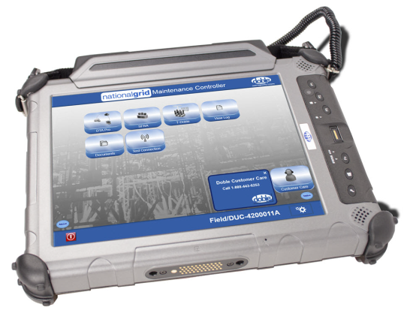
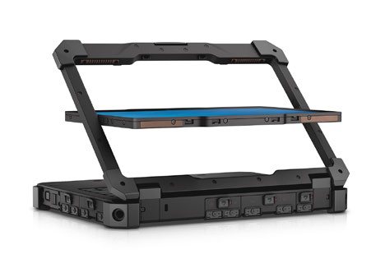
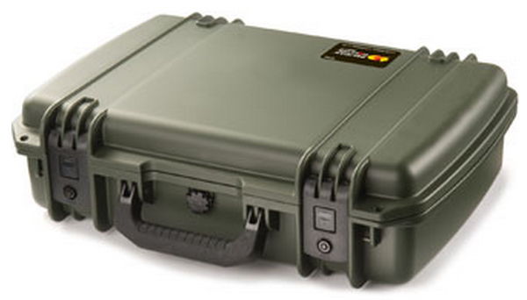
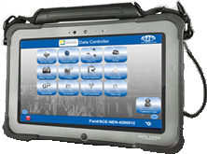
DUC/DUC-Enterprise Development Plan
Hardware
Software
DUC
Launcher
PC Imaging
dobleSYNC
Remote Support
DTAWeb
Security
Protection
Web
Remote Update
dobleSYNC
Forms
3rd Party Applications

Slide 47
May DUC Enterprise™ (Eversource – Pilot 2)
Customer Status
Eversource DUC-E Pilot Phase 2 (starting April for 60 days) https://doblewiki.doble.com:8443/display/PROD/Eversource
Requirements
20 Dell laptops (Preferred to Xplore C6 tablets)
Per Solutions, same features and applications as at end of Phase 1
Completed Tasks
PO received 3/1
Top level assembly for Dell (with blue cable bag) -- orderable
Mouse orderable as an accessory
Quick start card
User guide (replaces admin guide)
Hard case for Dell laptops
Enable wireless broadband through Eversource
Image the Dells at Whalley, first article review
Prototype of DUC-E portal
Software image for Dell
April 12-14 delivery of DUCs to Eversource -- Mini kickoff meetings April 12, 13, 14
May 12: Updated software image with additional features and application software
In Progress Tasks
Additional software update during pilot
Next Tasks
PO for 3 14-Inch Dell Eversource Contractor DUCs (may require tighter lock downs and a different image)
Productize DUC-E reporting portal (additional resources needed)
Establish effective customer care process

Slide 48
May DUC Enterprise™ (TVA)
Customer Status
TVA DUC-E Pilot- https://doblewiki.doble.com:8443/display/PROD/TVA+-+DUC-E
Completed Tasks
Discovery with Customer
Image Building
SQA of Image
Kit and ship -- August
Training with customer week of 10/9
Return updated DUCs before training with new admin password
DTA6 Pro training Jan 20-21 (many of the pilot issues were due to lack of training)
Restore DUCs (Admin password distributed to all users who modified the DUCs to act as standard laptops)
Returned the DUCs at Solutions request with no changes – could not reproduce VZ issues
Kickoff meeting Feb 18 to restart the pilot
Extending pilot through April (~45 Days) -- weekly pilot meetings led by Implementation Manager
Weekly usage report
No connectivity issues reported
Changed admin guide to a user guide (without the admin password)
Pilot complete
In Progress Tasks
Next Tasks
Close-out meeting June 14

Slide 49
May DUC Enterprise™ (National Grid)
Customer Status
National Grid Apparatus DUC-E - https://doblewiki.doble.com:8443/display/PROD/National+Grid
66 DUCs
Bringing back in groups to install new software image with updated applications, remote update application, remote access application, and to fix the NETBIOS issue (contractual commitment – about half done)
Licenses received for remote update capability
Added new enhanced folder structure
Testing software image. Engineering will reimage first batch of DUCs due to issues encountered with wireless broadband connectivity and need for more detailed instructions for Whalley
dobleSYNC released to support large file sizes (1.0.1.114)
National Grid Protection DUC-E Pilot - https://doblewiki.doble.com:8443/display/PROD/National+Grid+--+Protection+Pilot
Description
Protection
10 DUCs
Risks
Completed Tasks
Opportunity review meeting Jan 14 1pm (Nat’l Grid, Albany)
Meeting 4/20 to discuss requirements
15 Dell DUCs and accessories on order
In Progress Tasks
Next Tasks
PO and requirements

Slide 50
May DUC Enterprise™ (Additional Opportunities)
Additional Opportunites
ITC Transmission – Purchase 5 DUCs to replace 5 M4200s (dobleSYNC, DTA Pro, SFRA
Xcel CIP compliant mini-DUC: Meeting week of 3/4, under review by Xcel compliance group
ComEd (10 NERC CIP protection DUCs)
SCE (Southern California Edison) – IT pushing to pursue their own solution
BC Hydro
Austin Energy
AETCo (American Electrical Testing): 2 contractor DUCs for Eversource
Oncor: Pilot Protection and Apparatus
Other
Security evaluation by Abidance with summary report that can be used as a sales tool. SOW in process.

Slide 51
FY2016 DUC Enterprise™ Development Plan
10
11
12
1
2
3
4
5
6
7
8
9
Application Whitelisting Server
Disk Encryption Server
Infrastructure →
Offering →
Customers →
Start Eversource
Pilot
Xcel
End Eversource
Pilot Phase 1
Start
Eversource
Pilot Phase 2
End TVA
Pilot
Start Eversource Contractor
Pilot
Start Nat’l Grid Protection
Pilot

Slide 52
Datacenter
Engineering Datacenter Plan
Return to Table of Contents

Slide 53
Datacenter Security
Hosted Data Center
SOC2
24 Hour Security
Badged Doble Employees
Security Check In/ Out
Secured Cabinets
Secured rooms
Biometric Entry
Man Trap Zones

Slide 54
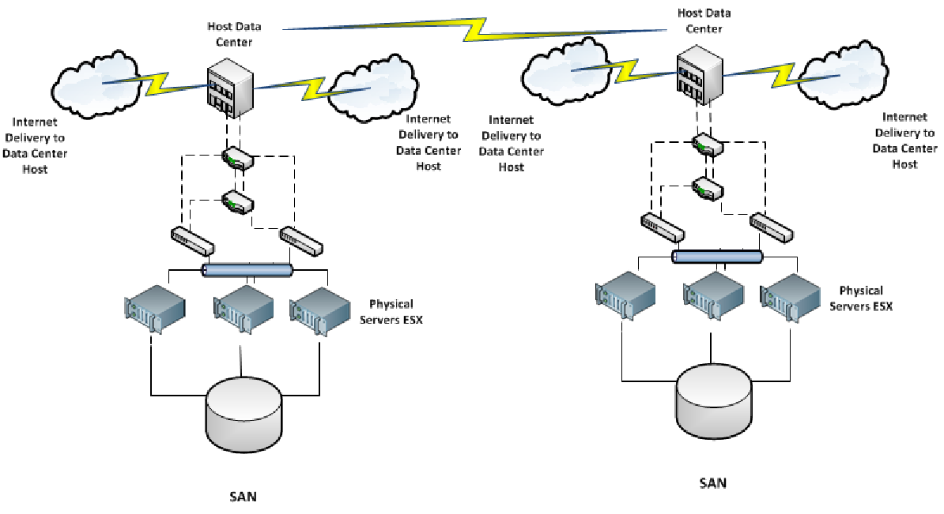
Datacenter Architecture
100 MB to 100 MB Redundant Bandwidth Host Data Center to Secondary Host Data Center

Slide 55
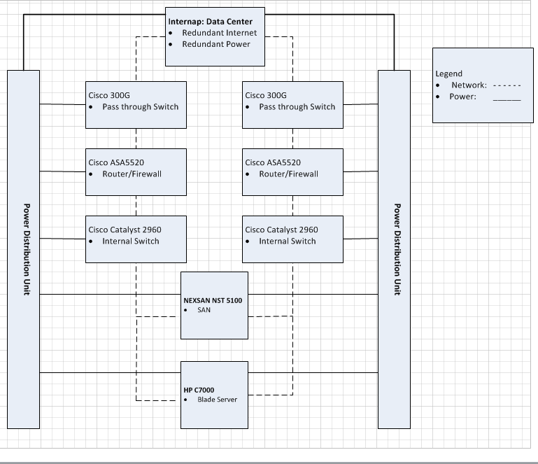
Datacenter Block Diagram
Redundant architecture to provide reliable failover and uptime at each datacenter.

Slide 56
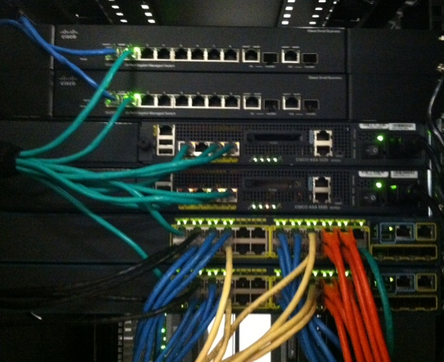
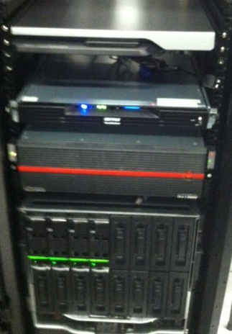
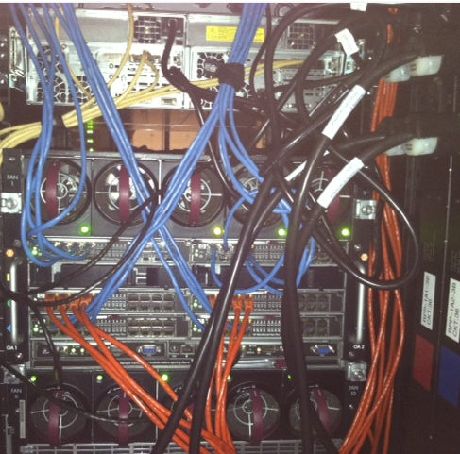
Datacenter Hardware Configuration
Both Datacenters built with the exact hardware and configuration to reduce
probable cause issues.
Color coded cabling to quickly identify network maintenance and configuration needs.

Slide 57
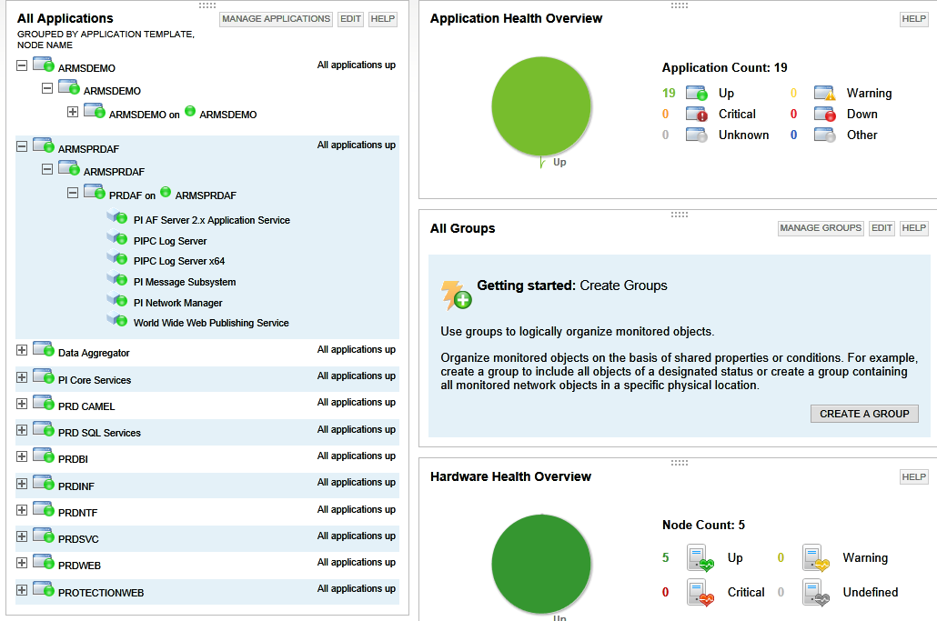
Datacenter NOC Systems
Robust Monitoring System that is expandable to the needs of each application

Slide 58
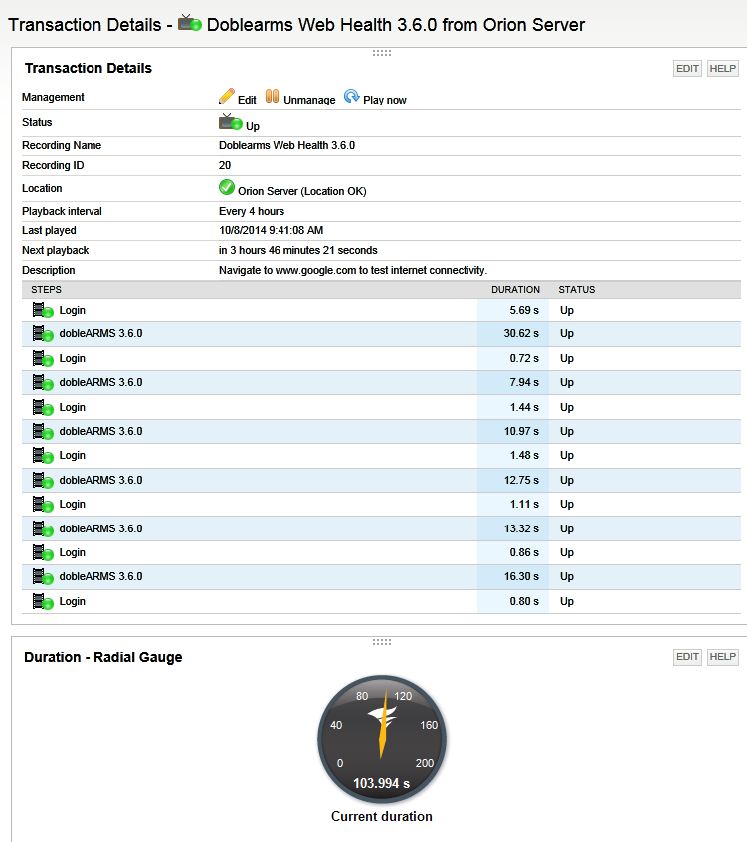
Datacenter NOC Systems
Robust Monitoring System with the ability to view our product website, as a simulated
customer to ensure proper response times at the website level.

Slide 59
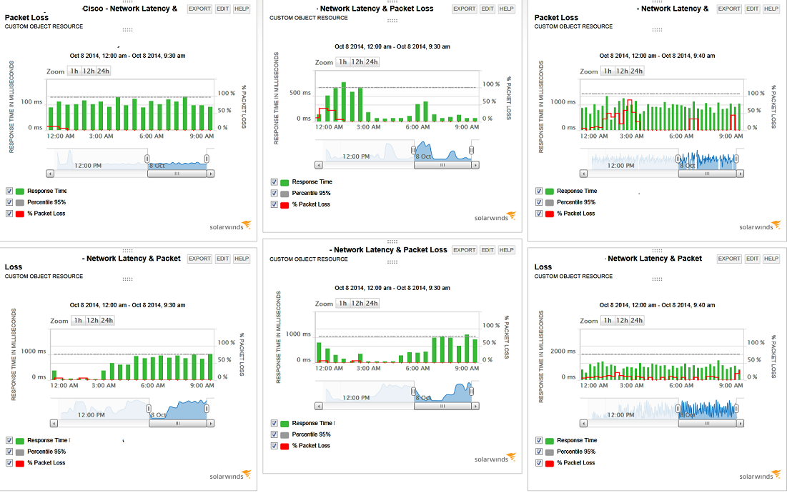
Datacenter NOC Systems
Robust Monitoring System that is expandable to the needs of each application

Slide 60
May Datacenter™ Status
Datacenter Activity
Data Center LA
DTAWEB build in progress. Delayed until New Simplivity solution s in place. 6-2016. This will now need to be reviewed since Simplivity has been delayed.
Data Center Failover Capability (first step) Note that replication is in place but it is static data that is provided.
In the event of detected data center failure there will be a failover from one Data Center to the other with a limited outage time. Delayed until New Simplivity solution s in place. 6-2016. Delayed per executive team until 2017
HA for the software product has been turned over to the SM. Peter Santiago is working this solution in DEV. Because of a need for licensing, new DEV and SQA environment/build this project is currently on hold. No status update on decision from executive team.
From a hardware perspective this has been completed and both Datacenters communicate successfully since July 2014.
The ability to replicate data from one data center to another. ARMS and ProtectionWeb Completed.
DTAWEB is now fully replicated to the LA Datacenter. Completed
Build two test PI servers for Peter Santiago and Luis Chaylian test HA PI HA in development. This was successful. Plan on completion 11-2014 Completed
Build two test AF servers for Peter Santiago test AF HA in development. Plan on completion 2-2015
Build two IIS Server Cluster for Peter Santiago to test web server failover HA – Completed 3-2015
Build two INF Server Cluster for Peter Santiago to test web server failover HA – Completed 4-2015
High Availability solution presented to the ARMS Engineering team for no outage product. Identifying design team to complete project. ETA 12/1. Core Team: Peter Santiago, Louis Serio, Luis Chaylian, Michael Vashevko, Matt Garber and Jason Allison. –Completed
New hardware Solution to Simplivity will change the HA approach. Old HA solution will not be needed. This is Now on hold. Push to bring back a committee to solve this project solution.
Load Balance /MULTI DNS
This project is to prepare for software HA solution for ARMS and Doble applications. Plan on completion by 11/1
Datacenter has NAT setup for Servers. The ability to add multiple public IP addresses pointing to both Datacenters is in place
Load balancing is in review. This is part of the initial Datacenter build. It will be needed as an enhancement to the software Load Balance through Multi DNS. Procured
Scheduled three vendors for Q&A for ARMS Software HA solutions. Quotes from three vendors have been presented.
Hardware Server/SAN
New hardware Solution to Simplivity will solves this project. Expected install of Q2 2016 Delayed per executive team until 2017

Slide 61
May Datacenter™ Status
Datacenter Activity
Antivirus Project
Migrating to a more robust Sophos solution
Cutover scheduled to be completed mid September
Sophos Central Server build: Completed
Server reboots in production needed to fully assign the resource of servers. Scheduled June 2016 during OS patching
TAESA
DEG and mDEG Build completed
IPSEC Tunnel-Waiting on TAESA information and schedule
LAMAR IPSEC Removal.
Tunnel removal and configuration to allow internet traffic for EXCEL LAMAR. This was a unscheduled project. Currently waiting on specs from Steve Conner to Ken Elkinson.
Datacenter recommendation to have Doble Prime team send out their cellular solution for Prime. IPSEC tunnel will be removed.
Eversource SFTP project:
Build SFTP solution to host data for Eversource field personnel in Datacenter
Target completion TBD
Introduced appliance solution. 2 servers one for DSDC-BOS and LA.
Procured solution and built first phase server to be shipped to LA
ENOSERVE:
Project to host Powerbase in the Datacenter
Built Test server in DEV for testing. Waiting on team to test solution. On hold
Estimate given to Dave ready for needed equipment. Waiting on determination of project.
TVA additional DEG Build
Build second DEG for TVA for pilot /LAB site. Plan on completion by 12-4-2014. Completed.
TVA Shipped to TVA
TVA additional IPSEC Tunnel Build Cancelled . On Hold. No status update from Solutions.
HP Blade patching and firmware upgrade: Standard Maintenance
The HP Blade system firmware needs to be updated. LA- Scheduled for new Firmware June 2016. BOS – July 2016
s Update patchwork scheduled for April 2016: Rescheduled for May 5th 2016 This was delayed by Solutions due to unscheduled DEMO.
UAT MS OS patching completed
PRD patching June 13th through 16th. Schedule reserved through Datacenter process

Slide 62
May Datacenter™ Status
Datacenter Activity
IT Scheduled Maintenance Procedure
Presented to Business Solutions. This process will be implemented as a guideline when IT Maintenance is needed. Business Solutions needs to acknowledge and understand this necessary procedure.
No updates from Business Solutions to date. This is still outstanding.
Updates were performed at the Datacenter BOS using this process. This is now the process and needs to be supported from management.
Sent to management team. This is now the process. Completed.
Currently the datacenter installs ALL Microsoft patches as been the case since the Datacenter was built.
Issue: Engineering does not have a proper strategy to test after patching. This is an SQA function not a DATACENTER function
SQA needs to produce a list of patches that cannot be applied. This is an SQA function not a DATACENTER function
Quarterly LA Site Visit: Scheduled Trip June 2016 and October 2016
Schedule work to take place first week June. -
HP Firmware Upgrade Blade/ ILO/ Enclosure.
Hardware review -
HA Testing –Blades/Routers/Switches/Power
NEXSAN - Firmware upgrade
DSDC-BOSTON
HP Firmware Upgrade Blade/ ILO/ Enclosure. Planned for July 2016
Windows updates needed. Planned for July 2016
NEXSAN - Firmware upgrade Planned for July 2016
NOC
Need to procure additional monitors for NOC – In Process
Sign for the NOC to be created and posted. – Created. Rename needed to include all products and not just ARMS.
NEXSAN Firmware Upgrade: Standard Maintenance
The SAN (Storage Area Network) firmware needs to be updated. Plan on completion by 11/1. New Firmware to be released in December. Rescheduled to reduce outage need. Date TBD based on firmware release date. New Firmware available. Scheduling for planned outage mid February 2015 Completed
Additional SAN for the DSDC-BOS has been sent for purchase request. This is needed to allow growth for the addition of DUC,DobleSYNC and Pilot Commissioning tool.
Additional SAN for the DSDC-BOS installed and configured. We have expanded storage at the DSDC-BOS

Slide 63
May Datacenter™ Status
Datacenter Activity
DobleSync/DUC
Waiting on final architecture plans for build. Completed.
Software and hardware quotes to be created for expansion. PRD is completed.
Introduction of Mongo Database has been brought into the DobleSync Forms. There are security risks presented from Datacenter Manager and Architect that must be addressed through the development team. Completed.
Servers built on time for the DobleSync Forms.
UAT Servers need to be built. Completed.
UAT quotes are presented and need to be procured. These are Mongo. and Microsoft SQL. Need to confirm if Mongo is paid for in UAT. Changed to SQL Express. Procurement no longer required.
Pilot Commissioning Tool (PCT)
Pilot Commissioning tool built in UAT environment..
This changes some of the ARMS testing as it is not longer the same product in both UAT and PRD. I have recommended that Pilot Commissioning Tool (PCT) be built in its own environment that mimics Demo. Date for June 2016
I have recommended that Solutions create procedures (There were none at the time) for the Creating, Decommissioning and inventory of all Pilots so they can be managed properly. This is a Solutions project but wanted this noted in this report. These procedures are still outstanding and or not enforced.
Currently there are many customers in there and there is no proper inventory to keep track.
Request to move out of UAT is 9 months overdue with no status updates or project plan from Engineering.
Notification Review Process
Review current notifications. Solarwinds consultant acquired to review current alerts. Work to take place through July 2015 work continues through September due to scheduling conflicts. Extended to November December.. Completed.
Note: There will always be additional adds to this. We have seen one for PI asked to added to monitoring that was not on the original requested work sheet.
Policy Mandates:
Now that ARMS has real customers purchase we must adhere to proper policies and procedures.
Access controls, originally presented in 2013 and revised in 2015 must be signed and posted. We can no longer work and test in production. Outstanding
Automated implementation. Regardless of the product we decide on and the proof of concept of the working mechanics, we must have a policy in place for the implementation process. This will also be governed by ACCESS controls. In process.. Implementation Manager only was designated as the Push and SQA for backup. We have had development team push in Octopus. This has been reported. Waiting on next steps to rectify.
Change Management. We need to have proper Change Management governing all work to be performed in the Datacenter. I will be working on specific products designed for to follow the Change Management. This will be part of the work flow required to receive the Access Control. Outstanding

Slide 64
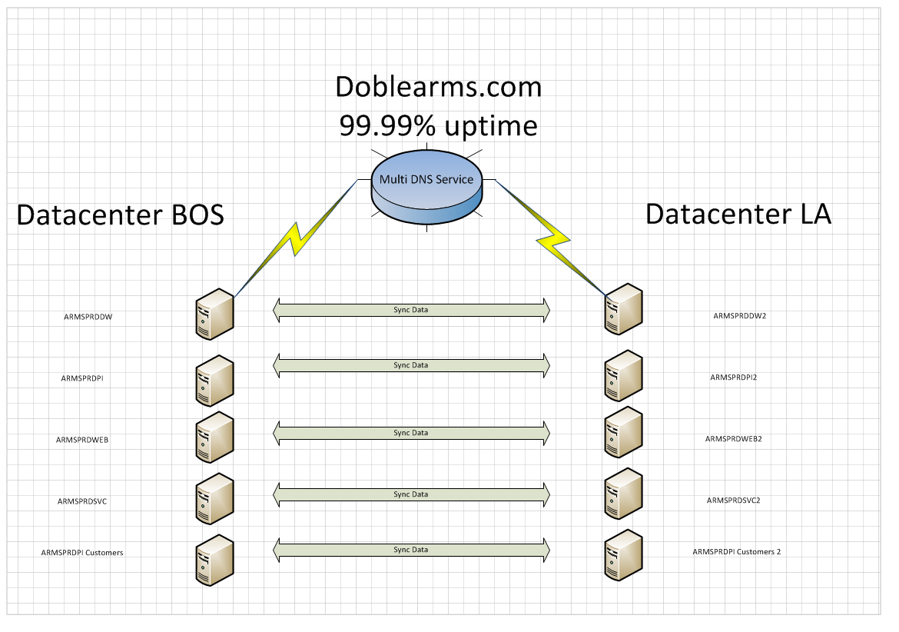
dobleARMS TM Simplivity Synchronized Server Solution
High Availability proposal presented to DobleARMS Engineering for HA of DobleARMS
This model will be applied to Protection Web and DTAWEB
New Solution to incorporate Simplivity at both Datacenters
Currently on hold

Slide 65
FY2016 Datacenter Plan
10
11
12
1
2
3
4
5
6
7
8
9
SolarWinds
Upgrade
DSYNC Server Environment build in DSDC-BOS
DSDC-BOS Server Maintenance/Memory Upgrade
Multi SAN at DSDC-BOS to enhance data redundancy and Storage Capacity
Infrastructure →
HA Phase 1 Replication- Failover
Offering →
vCenter Server Upgrade and relocation project
IT Maintenance Schedule Procedure
NOC Relocation to SQA Conference Room
Pilot Commissioning Tool Project
Betas / Pilots →

Slide 66
FY2016 Datacenter Plan
10
11
12
1
2
3
4
5
6
7
8
9
Network Switch Upgrade to 10 GB
HA Simplivity On HOLD
Infrastructure →
Service Environment
New DEV and SQA Environments
Offering →
Pilot Commissioning Tool Project Move out of UAT
Betas / Pilots →

Slide 67
Innovation Center for Online Systems
Engineering Development Plans
Return to Table of Contents

Slide 68
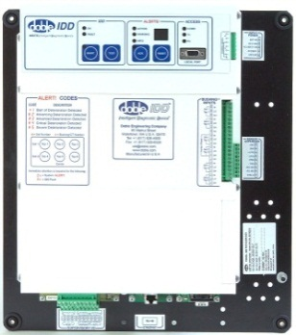
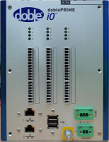
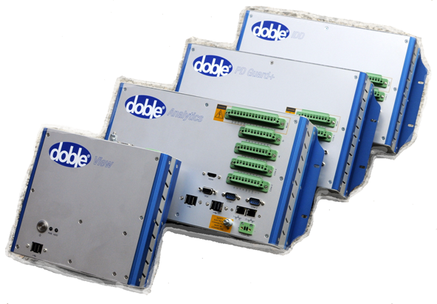
Intelligent Diagnostic Devices (IDD)
Hardware
Software
IDD
IDD
Firmware
doblePRIME
Prime Code
Embedded OS, DAS, Expert System, UI
Monitors
Embedded Firmware for dP IDD, PD-Guard
Return to Table of Contents

Slide 69
doblePRIME System Architecture
Data Acquisition Server
(DAS)
Prime System
Architecture
Data Acquisition Monitor (DM)
. . .
Data Acquisition Monitor (DM)
Sensor
. . .
Sensor
Device being Monitored
Device being Monitored

Slide 70
May doblePrime Family Status
Prime Code (Operating Software for doblePRIME systems )
Prime Code will release both for x86 hardware platforms (e.g. Analytics) and also ARM platforms (e.g. dP IDD)
v2.3 Initial analytic capability
Features include
True Power Factor (TPF) for CLP
ARMS-like UI and Dynamic Charts
Beta release in December ’15 to mollify Drax
Demonstration was successful, resulting in revenue.
4-20mA output conversion for MiniDelphi inputs – for Drax
Also successfully demonstrated in December Beta
Final candidate 2.3.0.27 released March ’16
Deployed on all doblePRIME IDD held in stock
v2.4 UI upgrade and further analytics – preliminary work in progress, detail in planning
Including
New UI framework with associated benefits
Supervisory level integration (ARMS and others)
Composite charts
Polar charts
Beta version successfully displayed at Boston Client Conference
2.4.0 entering SQA at the end of May ‘16 for release end June ‘16

Slide 71
May doblePrime Family Status (cont.)
doblePRIME PD-Guard Rev A (Basic PD detection platform, 8 channel)
Compliance testing completed – CE marked
Units in-stock UK (DPPD100)
Omnify bulk data entry completed, with final ECN signoff December ‘15.
User Guide – completed and released
Service and Repair Guide – complete, in release process
Current firmware release: 1.2.619
Includes phase-resolved measurement
Released as v1.2 in March 2016 with PRIME 2.3
Firmware development continues: v1.3 to include new entropy metric for improved PD discrimination
Call for feature requests to be developed for the next-generation platform

Slide 72
May doblePrime Family Status (cont.)
doblePRIME IDD Rev A (Bushing monitoring, data aggregation)
Basic online bushing monitoring
Based on IDD bushing DAC, with new Supervisory Interface Device (SID) design
With Prime Gateway module running Prime Code, can act as aggregator with reduced capability compared to Hub/Analytics platforms
Stage Gate 5 passed 27 August ’15
User Guide completed December ‘15
Omnify bulk data entry completed, with final product ECN release due by 11 December
System Voltage Module (SVM): modified bushing PCB to support True Power Factor
Boards tested in U.K.and available for development
Incorporated into prototype for successful demo at Florida Power & Light on 17 November
Shipped with China Light & Power order
Shipping to Watertown for integration and test support
This option will not be part of the initial product release
First batch of 50 doblePRIME IDD (DPID100) manufactured
15 have been converted to SVM version (DPID101)
Shipping with PRIME 2.3.1.2
Second batch build in progress with contract manufacturer
doblePRIME IDD Rev B
Hardware revision including IEC-61850 modules, additional I/O channels
Hardware design completed April ’16 – July ‘16 release scheduled
Firmware update in progress to include measurement of harmonics

Slide 73
May doblePrime Family Status (cont.)
doblePRIME iO
Multifunction i/o expansion module
Beta hardware shipped as part of CLP pilot
Beta unit shipping to CEM (Macau) end January ‘16
Parts in Omnify end January ‘16 – due for release May ‘16
doblePRIME Analytics System Rev A (COTS concept)
Advanced data concentrator platform, expanded sensor support and SCADA comms)
Omnify bulk data input complete - Product released
doblePRIME Analytics System Rev B (transition model)
Omnify bulk data input complete - Product released
Units in stock, UK
doblePRIME Analytics System Rev C (volume production model)
Hardware design complete – July ‘16 release scheduled
doblePRIME Hub Rev A (Basic data concentrator platform)
Compliance testing completed – CE marked
Units in-stock UK, ordered through Transinor
Omnify bulk data suspended, to focus on other products. To be resumed, tba.

Slide 74
May doblePrime Family Status (cont.)
Field Evaluations and Pilots in Progress
Drax Power (U.K.) – GT4 installed week of 6 July ’15 – giving good results
dP Analytics, dP IDD, dP PD-Guard, HFCT Mini, Prime Code
2nd installation on GT2 done in September
Prime Code v2.3 Beta delivered December ’15
Order for third and fourth systems received in March 2016
Third installation, GT5, completed May ‘16
Xcel (Lamar sub) paid pilot - shipped end of September
Installation throughout November, commissioned 3rd week of January ’16
CLP (China Light and Power) paid pilot
Requires True Power Factor – hardware and software changes
Equipment shipped Q1 FY16
Full software support in Q2 FY16
Pending Business Requiring Engineering Effort
EDF Energy Request for Proposal
Add support for GE/Kelman Transfix (future)
Integration with PI Historian (future)
Analytics for 2-bushing-only configuration (future)
APS (Arizona Public Service)
Polar plot support added for demonstration and proposal
FPL (Florida Power & Light)
True Power Factor gained approval
Duke Energy
Opportunity for 12,000 transformers

Slide 75
May - Other Prime Projects
Bushing tap sensor system
Transition bushing tap sensor system completely to Mil-spec circular connectors
Need to forecast demand for new components to trigger procurement, manufacturing
Need to train Sales and field personnel on changes, impact
Need to create new part numbers for BTA kits, get them into sales system
Need to document installation differences for installers
Requires active Solutions involvement to complete
Pre-terminated “pigtail” sensor connector cables designed & released, with CLP as first user
Rev required for simple Hirschman to Mil-spec circular conversion in progress May ‘16
Conversion kit designed to allow rework of finished goods Hirschmann-type sensors to Mil-spec connectors
Conversion kit will be released after transition of production to mil-spec occurs
Allows previously-built sensors in inventory to be converted to Mil-circular where appropriate
Bushing Sensor Redesign
Overhaul design of sensors – goals:
Eliminate risk of contamination that causes current drops
Reduce cost
Sensor redesign work commenced April ‘16

Slide 76
May - Other Prime Projects
Portable Platform (transportable enclosure for temporary IDD installations)
Completed in September ‘14
Shipped to KEPCO week of October 6th ‘14
Shown at 2015 conference
Will go into Omnify as product, but lowest priority
CB Tracker (Online circuit breaker monitoring)
Feasibility investigation and hardware/software proof of concept demo completed March ’15
Waiting for Solutions: business case emerging for further prototypes leading to a new product
Factory test fixtures
Factory test fixtures have been designed for full diagnostics of doblePRIME components and assemblies
Systems are transportable for deployment to any contract manufacturer or service center

Slide 77
May IDD (Legacy) Status
IDD Platform Support
Support for existing product - including adding support for new features and sensors, obsolescence issues, support to Client Service, Customer Service, Technical Applications Engineers
IDD Firmware v2.12.1
Fix capacitance calculation bug
Implement changes to expert system to better recognize and handle sensor problems
Issue “Info” alerts for current drops to zero
Prevent outage conditions from skewing expert system algorithms
Reduce false-alarm impact for operators
Released in December ’15
IDD Firmware v2.12.2
Fix DNP3 map bug
Complete and released
IDD Firmware v2.13
Localization update (Doble standard languages)
Improved Utility app for firmware upgrades to avoid
Follow-on to v2.12.1, target TBD based on resource balancing with Prime Code work
Legacy IDD going EOL Mid-2016

Slide 78
May IDD (Legacy) Status – cont.
IDD Field, Platform, and Customer Service Support
Solutions and Sales Support
Solutions Manager requests
Conduct and document testing of OV protection in IDD sensors for China Light and Power
Testing on standard and special-build sensor conducted
Report in progress for completion early December
Formalize alternative interconnect systems with remote protection modules
Develop generalized off-shore solution set
TAE request to provide conduit and termination box option to protect against animal damage and ease retrofit of legacy sensors to mil-spec connector sensors.
IDD Sales support for BTA selection
Steady, usually daily requests for tap confirmation
Reviewing process to reduce incidence of shipping wrong sensors, especially with large projects
Bushing sensor confirmation support and new designs transitioned to ICOS U.K., with support from PM in Watertown
Creating assembly/install instructions for new BTA kits and existing kits missing them

Slide 79
May IDD Family Status – cont.
Customer Service
Bushing Sensor Failures: Low resistance
Monitoring for any issues with sensors installed since new cleaning and testing protocols were introduced
Still getting frequent reports of current drop
First report that might be “cleaned” sensors being investigated
TAE’s and Customer Service handling replacements case-by-case
Platform/Production
Updated labels for IDD1
Make label kit to improve installer awareness of correct ground and sensor wiring
In queue for Mechanical Engineering

Slide 80
FY2015 Prime Platform Development Plan
Legacy
Platform:
doblePRIME:
CB Tracker
Concept Prototype
Bushing Module (New IDD) Beta Units
10
11
12
1
2
3
4
5
6
7
8
9
PRIME Code v2.0
Release to SQA
PRIME Code v2.0 Product Release
PRIME Code v2.1
Release to SQA
PRIME Code v2.1
Product Release
PRIME Code v2.2
Product Release
PD-Guard FW v1.0
Product Release
PD-Guard FW v1.1
Product Release
PD Guard FW v1.2
Beta
PD-Guard FW v1.1
Release to SQA
PRIME Code v2.3
Requirements
doblePRIME:
Legacy
Platform:
IDD FW 2.11
Final Product Release
IDD FW 2.12
Beta Release
IDD FW 2.12
Center Phase Release to SQA
IDD FW 2.12
Product Release

Slide 81
FY2016 Prime Platform Development Plan
Legacy
Platform:
IDD1 Label Updates
Prime:
Bushing Sensor
Redesign
dP Hub
Evo model
PDS/DFA New
Platform HW Concept Prototype
dP iO
Beta
dP PD-Guard
Rev B Prototype
Analytics v2 Cost Reduction
Evo model
10
11
12
1
2
3
4
5
6
7
8
9
PRIME Code v2.3
Drax Beta
PRIME Code v2.4
Conference Beta
PRIME Code v2.3
Product Release
PRIME Code v2.4
Product Release
PD Guard FW 1.3
Product Release
PD Guard FW v1.2
Product Release
dP IDD FW 1.1
Product Release
PRIME Code v2.5
Product Release
Prime:
Legacy
Platform:
IDD FW v2.12.1
IDD FW v2.12

Slide 82
FY2017 Prime Platform Development Plan
Legacy
Platform:
xxx
Prime:
xxx
xxx
10
11
12
1
2
3
4
5
6
7
8
9
xxx
xxx
Prime:
Legacy
Platform:

Slide 83
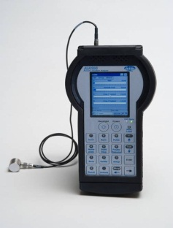
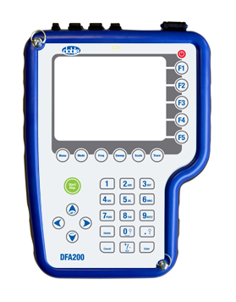
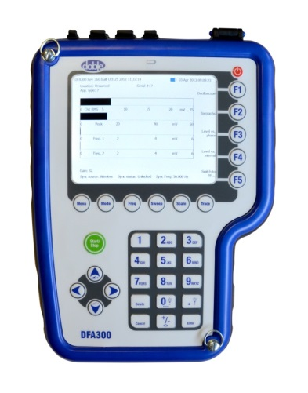
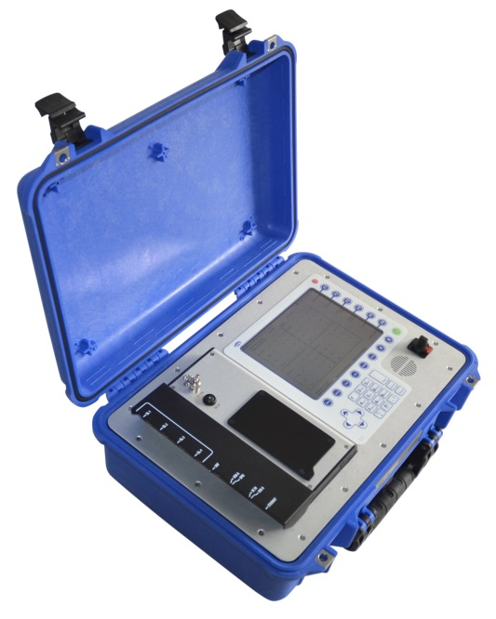
DFA-Series Engineering Development Plans
Hardware
Software
DFA100
DFA200
DFA300
DFA Viewer v2.0
DFA200/300 v1.0
DFA500 v1.2
DFA500
PDViewer v1.0

Slide 84
May Status DFA-Series
DFA300
DFA 300 FW complete, rev 1.1.615
Firmware modified for global wireless sync support
User Guide out for final review
DFA200
Design review in progress as part of DFA platform re-spin
FW updates complete, rev 1.1.614
Introduction to coincide with updated PDS/DFA screen
DFA Platform Re-spin:
Ongoing activity to define and refine requirements for next platform redesign
Concept testing in progress
Demonstrated first stage Software Defined Radio concept model
Additional Engineering resource due starting April‘16
DFA/PDS Display Obsolescence
Delphi portable display has been selected to replace existing obsolete item
Interface PCB and cabling design complete and tested
Case redesign – in production
DFA200 prototype with new display has been approved
Supporting Activities
Acoustic Antenna concept built and tested - business case required to make further progress
TeV probe sample testing at GCU completed – specification document complete (A. Nesbitt)

Slide 85
FY2015/16: DFA-Series Development Plan
DFA Platform Re-spin start
Display modification Design
FY15
10
11
12
1
2
3
4
5
6
7
8
9
DFA FW Update
for 429MHz
PDS/DFA
New Platform
HW Prototype
DFA200 Beta
FY16
10
11
12
1
2
3
4
5
6
7
8
9

Slide 86
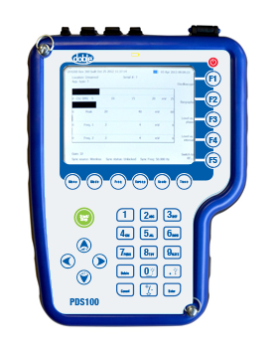
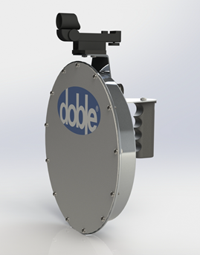
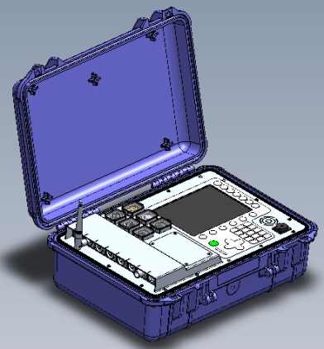
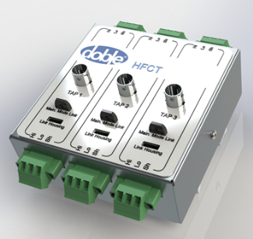
PDS-Series Engineering Development Plan
Hardware
Software
PDS100
PDS200
PDS200 v1.0
PDS500 v1.0
PDS Viewer v2.0
Directional Antenna
PDS100 v1.2
PDS500
HFCT
PDViewer v1.0

Slide 87
May Status PDS-Series
PDS 100:
Call off order for potential PDS 100 awaiting sales input.
PDS200 motherboards are now common with PDS 100
Common source for kits means shorter lead times
Latest firmware 2.0.613 to support new display and other features from PDS200
PDS 200:
Extended EMI field trial being carried out by GPS
Firmware updates in final review based on EMI field trials
Latest release: 1.1.617
This version adds an improved auto level algorithm and the ability to recall auto ref level information from results files, as well as some minor bug fixes.
Includes phase-resolved mode
Omnify special case
Treat as third party item due to external design and compliance issues
User Guide drafted and out for comments – will follow PD-Guard
Stage Gate 5 passed 27 August ‘15
Not including replacement display
PDS Platform Re-spin:
Ongoing activity to define and refine requirements for next platform redesign
Concept testing in progress
Demonstrated first stage Software Defined Radio concept model
Additional Engineering resource started April ‘16

Slide 88
May Status PDS-Series (cont.)
Directional Antenna:
In production
DFA/PDS Display Obsolescence
Delphi portable display has been selected to replace existing obsolete item
Interface PCB and cabling design complete and tested
Case redesign – in production
DFA200 prototype with new display approved. New case in production
Mini-HFCT probe
Units in stock
Additional batch of 50 units in production April ‘16

Slide 89
May Status PDS-Series (cont.)
PDS200e EMI Surveyor Kit
Request to bundle PDS200 with 3rd party sniffer instrument and various antenna and cable accessories – Engineering is actively working this
Initial case design complete with prototype foam on order with target date of 10 December
Preliminary bill of materials is in Omnify, awaiting final case design approval and documentation for release
Materials Management team reviewing included 3rd party products for pricing, support, warranty considerations
SG5 passed March ‘16

Slide 90
FY2015/16: PDS-Series Development Plan
PDS200 Omnify Documentation
Directional Antenna
Betas
Directional Antenna
Betas
Display modification
Low Cost HFCT prototype
Low Cost HFCT Product
FY15
10
11
12
1
2
3
4
5
6
7
8
9
PDS FW Update Release to SQA
Updated PDS100 Beta
PDS/DFA
New Platform
HW Prototype
PDS200e EMI Surveyor Kit
FY16
10
11
12
1
2
3
4
5
6
7
8
9
PDViewer
Updates

Slide 91
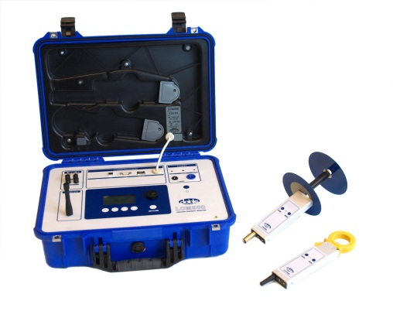
LCM-Series Engineering Development Plan
Hardware
Software
LCM II WL kit
LCM500
LCM500 FW v 1.21
LCM II FW
(for WL kit)
LCMViewer

Slide 92
May Status LCM-Series
LCM Hardware
Product Update to support Sales
Firmware updates complete: v1.26
Hardware updates complete
15 units delivered in December ’15
25 units delivered in January ’16
Next 50 on order
LCM Viewer software
Version 2.0.0 (more bug fixes and enhancements)
Out of SQA and available 1 December ‘15 as Beta pending Solutions review of Release Note
Note: previously planned v1.1 release was rolled into v2.0 to reduce SQA impact

Slide 93
FY2015/16: LCM-Series Development Plan
Revised Roadmap LCM
Obsolescence Update for LCM500
FY15
10
11
12
1
2
3
4
5
6
7
8
9
FY16
10
11
12
1
2
3
4
5
6
7
8
9
LCM Viewer
V2.0.0

Slide 94
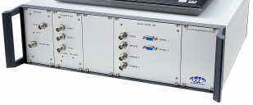
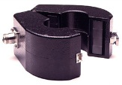
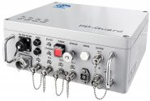
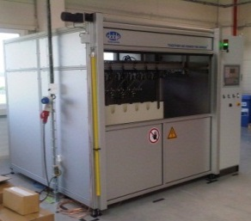
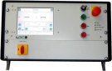
Lemke Product Engineering Support
Hardware
Software
PD-Smart 19” Housing
HFCT
PD-Smart DC, 0.1, 0.01 Hz
Reporting / Testing Software
Basic PD Monitoring System
Enhanced PD Monitoring System
R&D Engineering continues to provide support to Doble Lemke customers, both internal and external.
Lemke products will be in Jira for issue reporting
PD-Smart: sustainability review in progress to allow
continued production
fix or mitigate persistent hardware problems
HV Systems
HV Control Unit

Slide 95
May Lemke Support Status
PD-Smart
Undergoing review and redesign as required
To produce more units
To resolve issues in existing stock
Engineering worked with Operations to generate units for delivery
Attempting to reverse-engineer some aspects of UHF option card to allow manufacture and test
LDM-6/3
Reviewing documentation to allow for new production
Includes bushing tap adapters
Made mechanical design mods to ease procurement in the U.S.
Needed in support of orders
PT Jalamas – need three full sets, plus new adapter design
Adapter design and fabrication completed, and three LDM-6/3 units assembled and tested
Shipped in November
Prescon Power Solutions (Pakistan) – need adapters-only, to fit replacement bushings
Customer is returning existing adapters for conversion to different thread size
PO received and return of adapters is in progress

Slide 96
SQA and Documentation
Engineering Development Plan
Return to Table of Contents

Slide 97
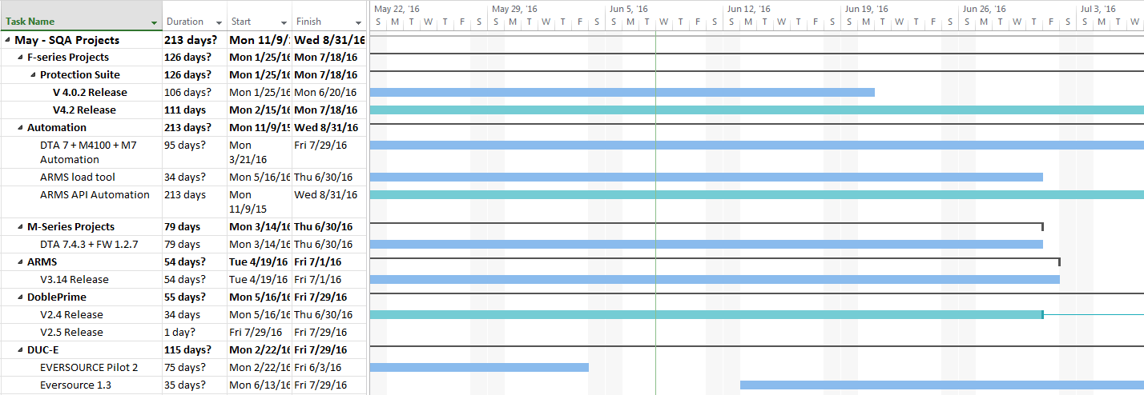
June 8th,2016 SQA Projects

Slide 98
June 8th,2016 SQA Projects
To be Completed
ARMS V3.13
DTA 6.4.2
On-going Projects
Automate ARMS Regression
Spring Conference
PS V4.2
DP V2.4
May 2016
June 2016
To be Completed
To be Completed
On-going Projects
On-going Projects
M4100 Automation
Automate ARMS Regression
PS V4.2
DP V2.5
DTA V7.5
Automate Doble Prime Regression
April 2016
PS V4.0.2
DUC-E Protection NG
DUC-E Protection NG
PS V4.2
ARMS 3.15
DP IDD 2.3.1
DP V2.3
DUC-E Eversource P2 1.2
M7 Automation
Sensor Simulator
DUC-E Eversource 1.2
ARMS V3.14
ARMS 3.14
ARMS ISGw deploy
DP V2.4
July 2016
August 2016
To be Completed
To be Completed
On-going Projects
PS 4.0.2
DobleSyncForms 1.2
DTA 7.4.3 FW 1.2.7
DP V2.4
Automate DUC-E Regression
ARMS 3.14
Automate ARMS Regression
DUC-E transition
Sensor Simulator
Sensor Simulator
DUC-E Regression Automation
PS 4.2
ARMS 3.15
DP V2.5
On-going Projects
DTA 7.4.3 FW 1.2.7
Automate Doble Prime Regression
Automate ARMS Regression
PS V4.2.1
DTA V7.5
DUC-E
Sensor Simulator
DUC-E Regression Automation
PS V 4.2.1
DP V2.6
ARMS 3.16
Automate Doble Prime Regression
Automate ARMS Regression
PS V5.0
DTA V7.5
DUC-E
Sensor Simulator
DUC-E Regression Automation
DobleSync 1.0 B114
DUC-E 1.3

Slide 99
June 8th,2016 Technical Documentation
April 2016
User Guide + Release Notes To be Complete
On-Going User Guide + Release notes
PS V4.2
May 2016
June 2016
On-Going User Guide + Release notes
On-Going User Guide + Release notes
User Guide + Release Notes To be Complete
User Guide + Release Notes To be Complete
DTA 6.4.2
iDoble password
PS V4.2
DTA V7.5
DP V2.4
DP V2.4
DTA 7.4.3
IDD to DP IDD application notes
DTA configuration diagram instructions
Newsletter
ARMS 3.14
New Online Help
ARMS Help rewrite
PDS Quick Start guide
DP IDD 2.3.1
SFRA 5.3.1
Delphi Mini User guide
DFA 300
ARMS 3.15
July 2016
August 2016
User Guide + Release Notes To be Complete
User Guide + Release Notes To be Complete
On-Going User Guide + Release notes
On-Going User Guide + Release notes
DTA 7.4.3
updated F6052 User Guide
ARMS 3.14
ARMS Responsive Online help
PS 4.0.2
PS 4.2
Delphi Mini User guide
DFA 300
ARMS 3.14
ARMS Responsive Online help
PS 4.2
ARMS 3.15
DP 2.5
Delphi Mini User guide
DFA 300
PS 4.2 fixing
DP 2.6
ARMS 3.16
PS 4.2.1
Delphi Mini User guide
DFA 300
PS 4.2 fixing

Slide 100
DGA Projects
Engineering Development Plan
Return to Table of Contents

Slide 101




Dissolved Gas Analyzers (DGA)
Delphi Hardware:
Software
Delphi Mini:
Delphi Diagnose
Delphi Mini:
With Oil Pump
Delphi Portable:

Slide 102
June 8th Status - Delphi Portable
Oil Lab Interference Testing
Different types of dissolved gasses in extracted oil from transformers are interfering with the Delphi Portable measurements.
Oil lab is continuing with the study of the interfering gases with the 1st report made available in February 2016.
Interferent Compensation via Software Algorithms
Phase 1 to develop compensation logic for ethane, propane, formic acid, and DRAX oil samples completed in May 2016.
Phase 2 & 3 proposals to get extraction rates for other identified interferents and software development are in review for approval.

Slide 103
June 8th Status - Delphi Portable
Design & Manufacturing – issues in review for resolution
Firmware update process
Solenoids valve test fixture
Bottle cap construction / leak tester
Transport lock mechanism
Calibration procedure
Chopper disc assembly
Internal blower noise
Cabling
Shipping packaging

